Slide 1
ML Modeling: LASSO, Ridge, Trees & Forests
Brian Quistorff & Matt Goldman

Slide 2
ML != Econometrics (OLS)
Machine Learning is good at selecting from many possible features to predict something.
Econometrics (OLS) is good at carefully measuring a small number of effects that we specify ahead of time.

Slide 3
Intro to Machine Learning
Machine Learning focuses on training models for predictive accuracy.
Good for: “How much will I sell next week?”
Different from OLS’s strength in parameter estimation.
Good for: How much more will I sell if I drop price? How certain am I about that impact; is it statistically significant?
Key Difference here is whether or not you attribute causality.
We will learn this week, that OLS estimates can sometimes have causal interpretations.
This is never the case with Machine Learning algorithms.
Why? Because ML is all about “shrinking” (i.e. biasing) the impact of individual features toward zero to get better prediction.

Slide 4
Should I use ML or OLS?
Two key questions to determine the answer:
Q1) Do I have in mind (before doing the analysis) a small* number of predictive features that I think drive my outcome?
A) If yes, you can use OLS if not you may need machine learning.
Q2) Do I want to assign a causal interpretation to my estimates?
A) If yes, you need to use OLS.
* Small is relative to the sample size. If you have many data points, you can estimate more complicated models with OLS.

Slide 5
How many features might be important drivers of my outcome?
Many
Few
What do I want to do?
Do I want to measure causal impacts?
Measure Causality
Prediction
Measure Causality
Prediction
Machine Learning
This is really hard!
Machine Learning or OLS
OLS*
* This does not guarantee you can use OLS to learn about causality. We will learn more about the conditions under which OLS reveals causal parameters, later this week.

Slide 6
Intro to Machine Learning
Machine Learning models are very flexible, but are penalized from adopting too much complexity. How does this work?
Idea: what if we make adding additional “stuff” to the model costly?
Same thing as spending $20 at the store
Must carefully evaluate if adding additional features to the model is “worth” it.
What do we mean by “worth it”?

Slide 7
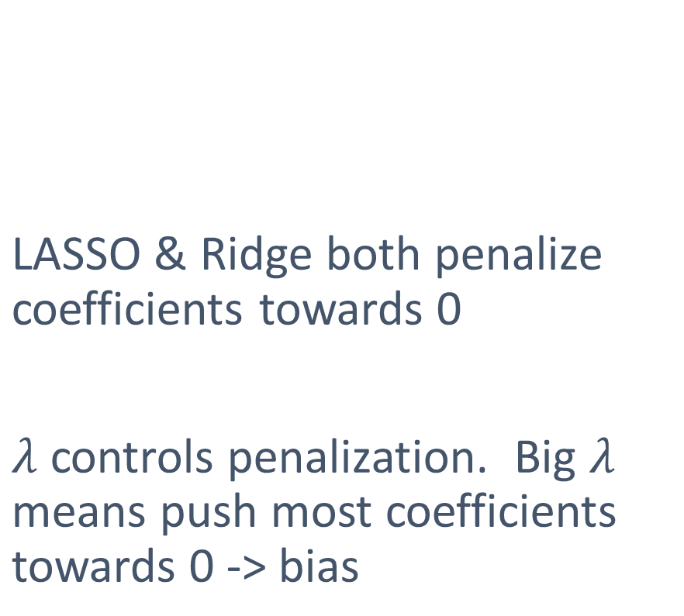
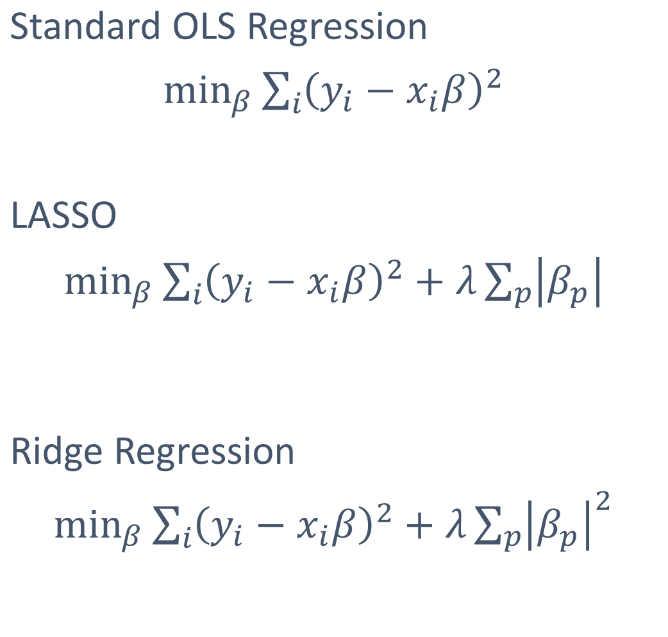
Linear Models: LASSO
Standard OLS Regression
$\min_{β}\sum_{i}{{\left(y_{i}−x_{i}β\right)}^{2}}$
LASSO
$\min_{β}\sum_{i}{{\left(y_{i}−x_{i}β\right)}^{2}}+λ\sum_{p}{\left|β_{p}\right|}$
Ridge Regression
$\min_{β}\sum_{i}{{\left(y_{i}−x_{i}β\right)}^{2}}+λ\sum_{p}{{\left|β_{p}\right|}^{2}}$
LASSO & Ridge both penalize coefficients towards 0
$λ$ controls penalization. Big $λ$ means push most coefficients towards 0 -> bias

Slide 8
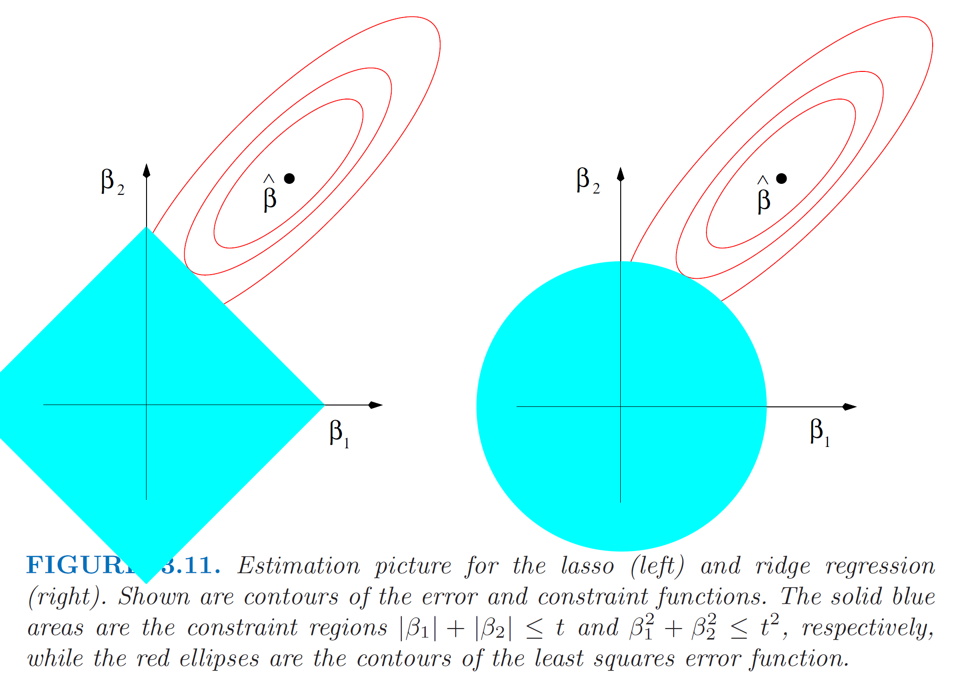
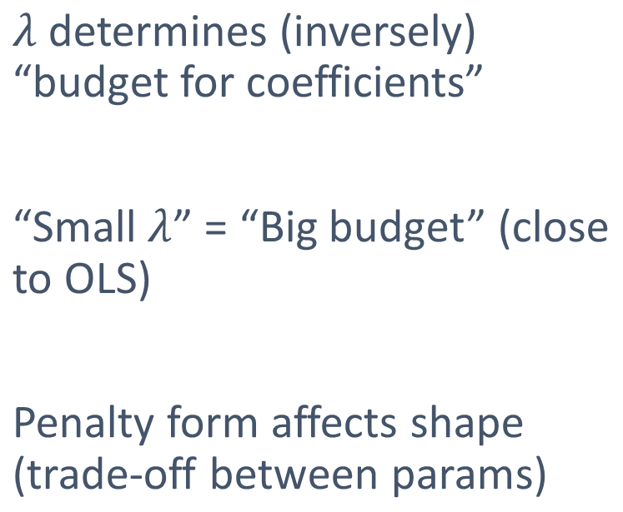
Coefficient Budget and Penalization
LASSO
Ridge
𝜆 determines (inversely) “budget for coefficients”
“Small $λ$” = “Big budget” (close to OLS)
Penalty form affects shape (trade-off between params)

Slide 9
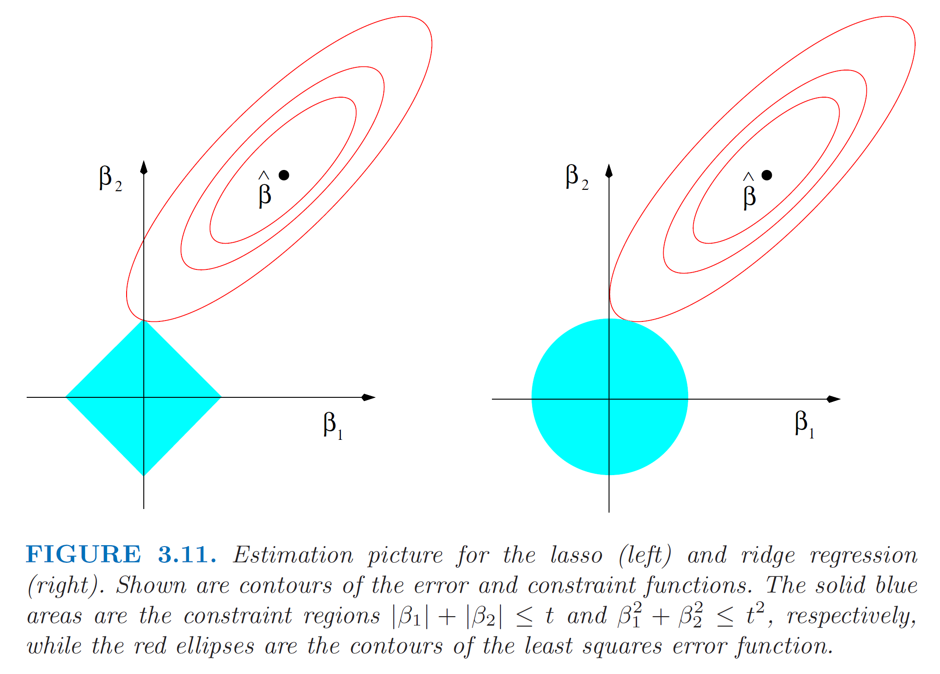
Coefficient Budget and Penalization
Ridge will smoothly make coefficients small
LASSO will push many coefficients to 0 (“model selection”)
LASSO
Ridge

Slide 10
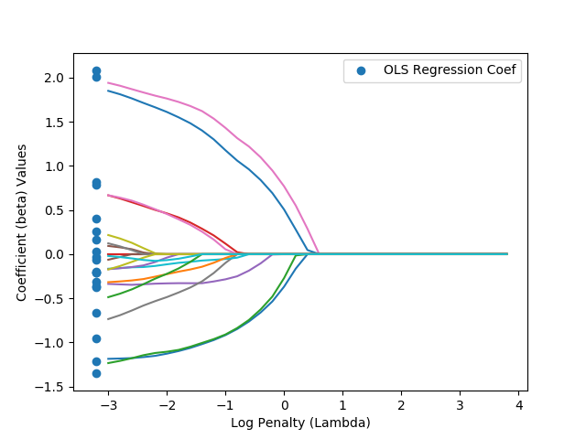
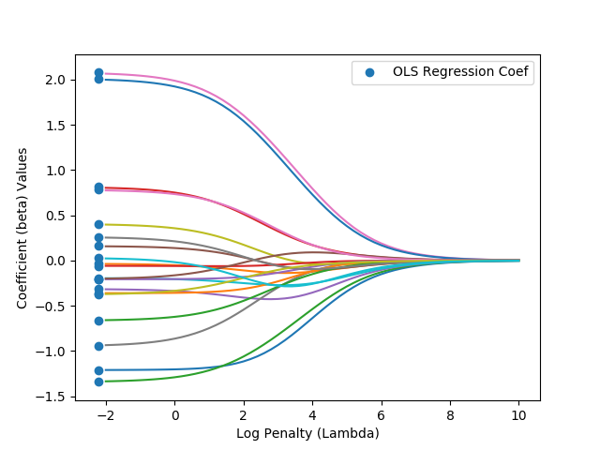
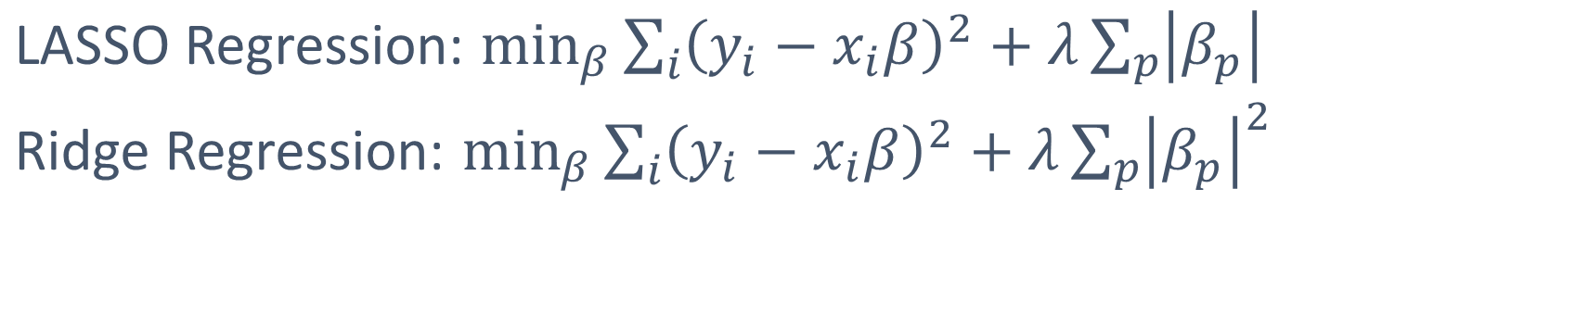
Lasso vs. Ridge: Which is Which?
LASSO Regression: $\min_{β}\sum_{i}{{\left(y_{i}−x_{i}β\right)}^{2}}+λ\sum_{p}{\left|β_{p}\right|}$
Ridge Regression: $\min_{β}\sum_{i}{{\left(y_{i}−x_{i}β\right)}^{2}}+λ\sum_{p}{{\left|β_{p}\right|}^{2}}$

Slide 11
Lasso vs. Ridge: Which is Which?
LASSO Regression: $\min_{β}\sum_{i}{{\left(y_{i}−x_{i}β\right)}^{2}}+λ\sum_{p}{\left|β_{p}\right|}$
Ridge Regression: $\min_{β}\sum_{i}{{\left(y_{i}−x_{i}β\right)}^{2}}+λ\sum_{p}{{\left|β_{p}\right|}^{2}}$
Lasso
Ridge

Slide 12
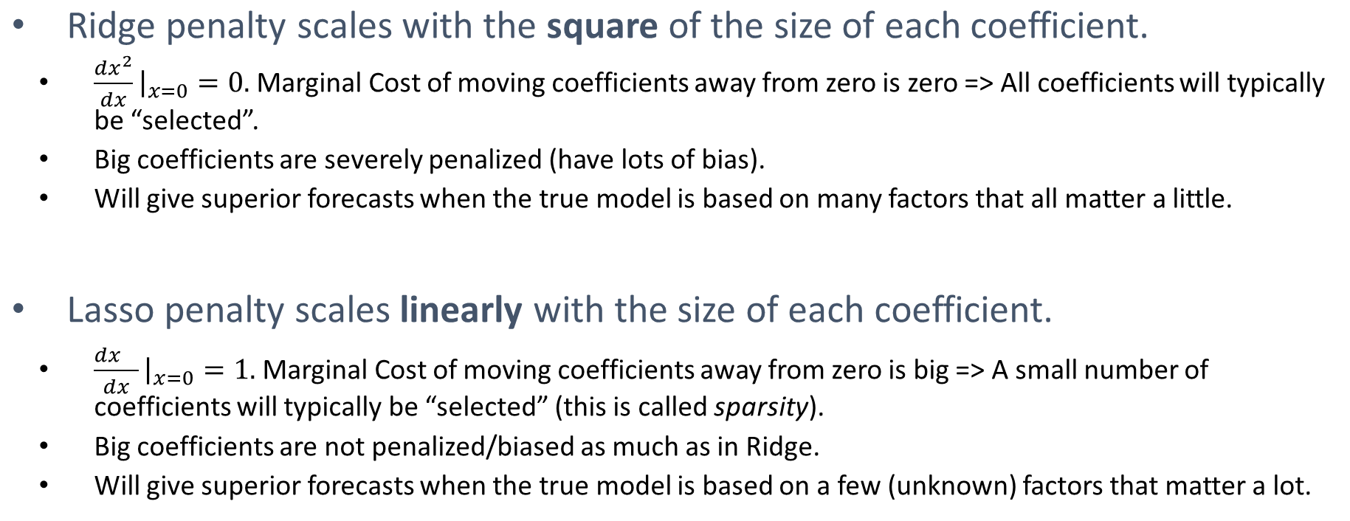
Lasso vs. Ridge: Which is Better?
Ridge penalty scales with the square of the size of each coefficient.
$\frac{dx^{2}}{dx}{\left.​\right|}_{x=0}=0.$Marginal Cost of moving coefficients away from zero is zero => All coefficients will typically be “selected”.
Big coefficients are severely penalized (have lots of bias).
Will give superior forecasts when the true model is based on many factors that all matter a little.
Lasso penalty scales linearly with the size of each coefficient.
$\frac{dx^{}}{dx}{\left.​\right|}_{x=0}=1.$Marginal Cost of moving coefficients away from zero is big => A small number of coefficients will typically be “selected” (this is called sparsity).
Big coefficients are not penalized/biased as much as in Ridge.
Will give superior forecasts when the true model is based on a few (unknown) factors that matter a lot.

Slide 13
Cross-Validation: Picking the Right Value of Lambda
How much should we penalize complexity?
Low penalty = Small Lambda (all coefficients close to OLS values)
Lasso
Ridge

Slide 14
Cross-Validation: Picking the Right Value of Lambda
How much should we penalize complexity?
High penalty = Big Lambda (all coefficients close to zero)
Lasso
Ridge

Slide 15
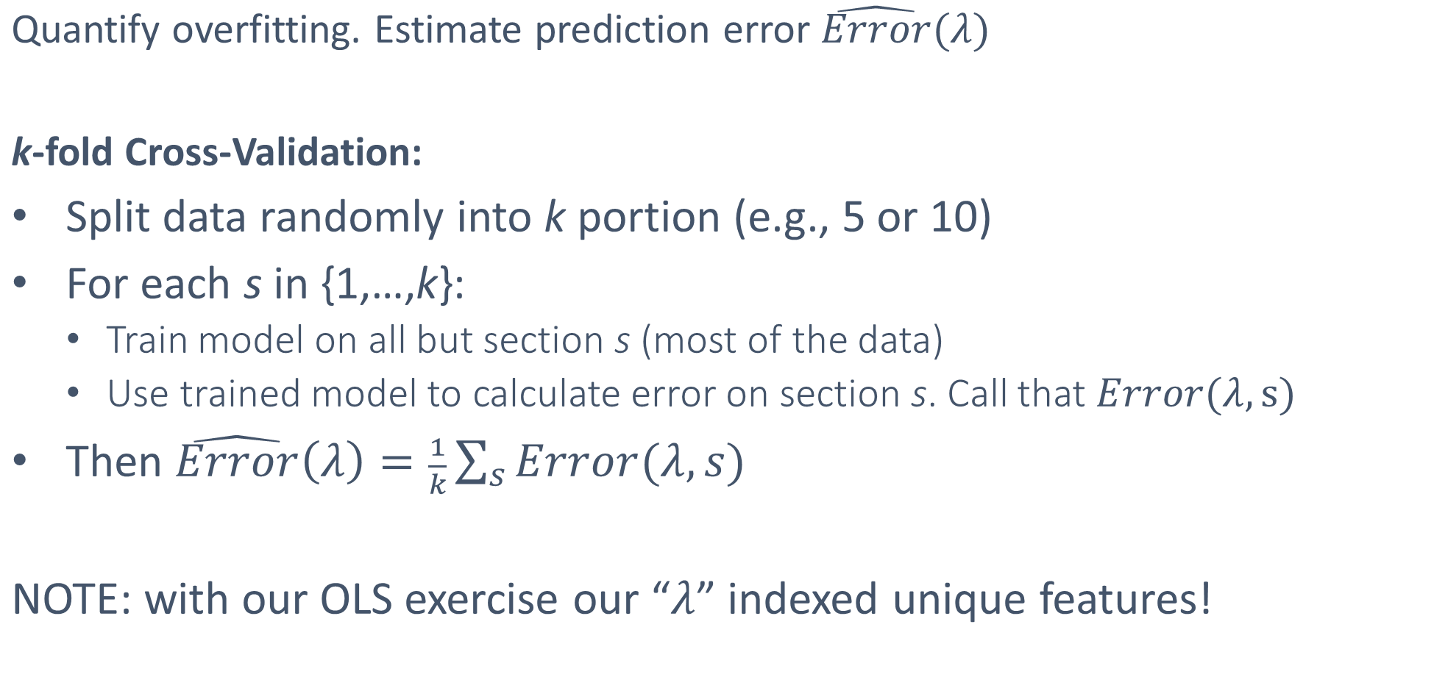
Estimating Prediction Error
Quantify overfitting. Estimate prediction error $\hat{Error}(λ)$
k-fold Cross-Validation:
Split data randomly into k portion (e.g., 5 or 10)
For each s in {1,…,k}:
Train model on all but section s (most of the data)
Use trained model to calculate error on section s. Call that $Error(λ,s)$
Then $\hat{Error}\left(λ\right)=\frac{1}{k}\sum_{s}{Error(λ,s)}$
NOTE: with our OLS exercise our “$λ$” indexed unique features!

Slide 16
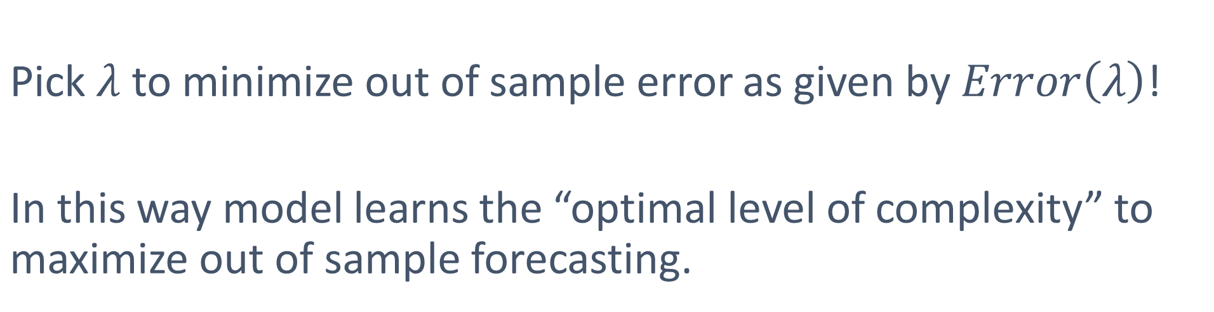
Overfitting Solution
Pick $λ$ to minimize out of sample error as given by $Error\left(λ\right)$!
In this way model learns the “optimal level of complexity” to maximize out of sample forecasting.

Slide 17
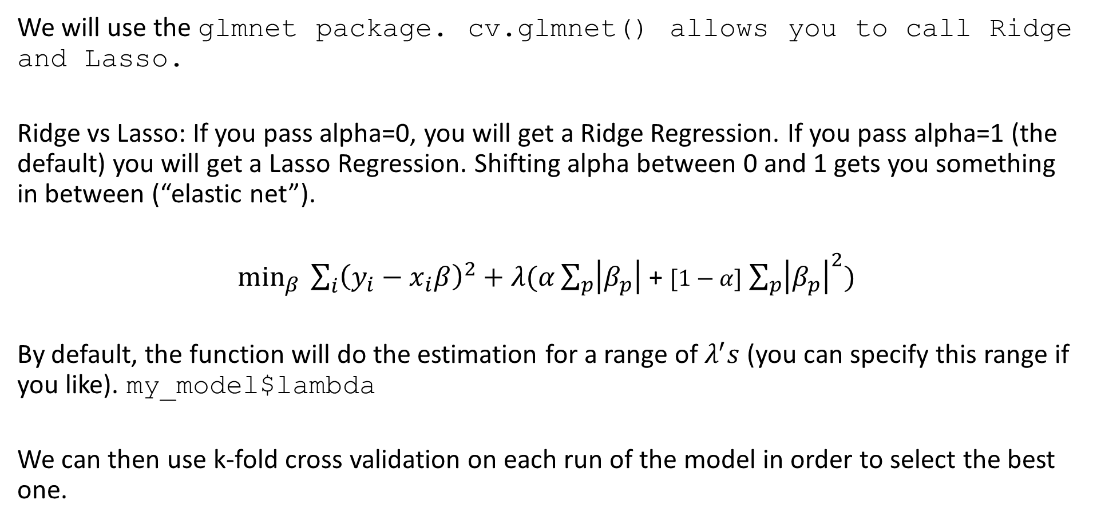
Lasso + Ridge in R
We will use the glmnet package. cv.glmnet() allows you to call Ridge and Lasso.
Ridge vs Lasso: If you pass alpha=0, you will get a Ridge Regression. If you pass alpha=1 (the default) you will get a Lasso Regression. Shifting alpha between 0 and 1 gets you something in between (“elastic net”).
$\min_{β} \sum_{i}{{\left(y_{i}−x_{i}β\right)}^{2}}+λ(α\sum_{p}{\left|β_{p}\right|}$ + $[1−α]$ $\sum_{p}{{\left|β_{p}\right|}^{2})}$
By default, the function will do the estimation for a range of $λ^{′}s$ (you can specify this range if you like). my_model$lambda
We can then use k-fold cross validation on each run of the model in order to select the best one.

Slide 18
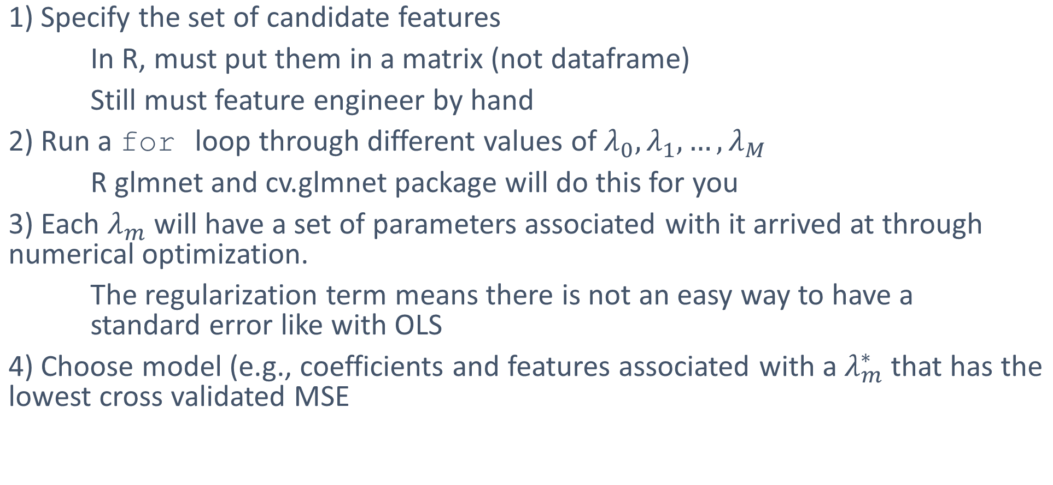
LASSO Algorithm
1) Specify the set of candidate features
In R, must put them in a matrix (not dataframe)
Still must feature engineer by hand
2) Run a for loop through different values of $λ_{0},λ_{1},…,λ_{M}$
R glmnet and cv.glmnet package will do this for you
3) Each $λ_{m}$ will have a set of parameters associated with it arrived at through numerical optimization.
The regularization term means there is not an easy way to have a standard error like with OLS
4) Choose model (e.g., coefficients and features associated with a $λ_{m}^{∗}$ that has the lowest cross validated MSE

Slide 19
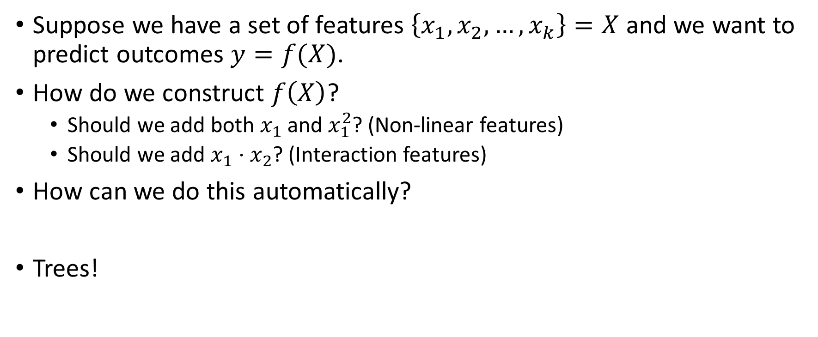
Why trees?
Suppose we have a set of features $\left\{x_{1},x_{2},…,x_{k}\right\}=X$ and we want to predict outcomes $y=f(X)$.
How do we construct $f\left(X\right)$?
Should we add both $x_{1}$ and $x_{1}^{2}$? (Non-linear features)
Should we add $x_{1}⋅x_{2}$? (Interaction features)
How can we do this automatically?
Trees!

Slide 20
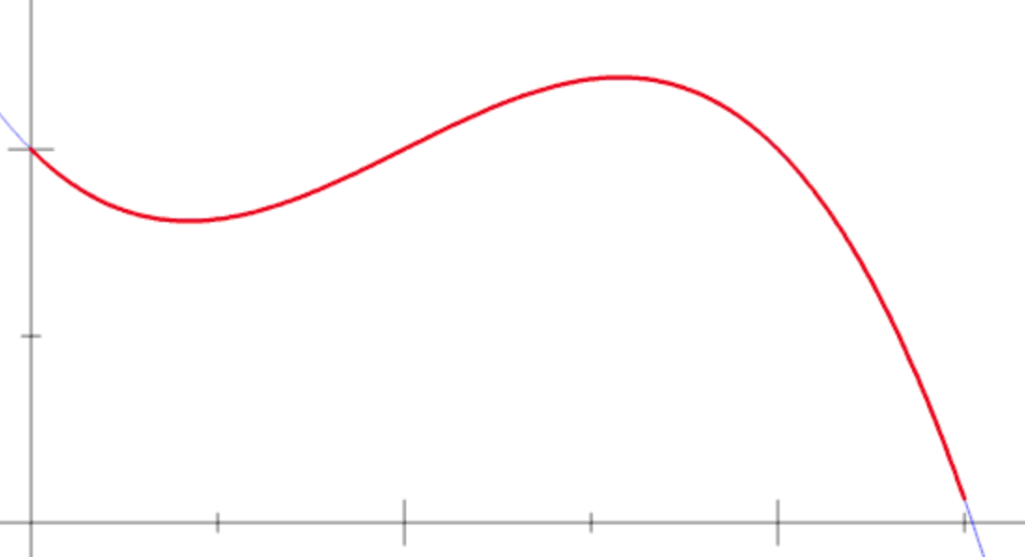

Building to trees intuition
Suppose you only had one feature $x_{1}$ and $f(x_{1})$ was funky.
Suppose instead we want to estimate the area under $f(x_{1})$. What’s a numerical way to do that?

Slide 21
Building to trees intuition(cont.)
Split up the graph into sections and work on each individually

Slide 22
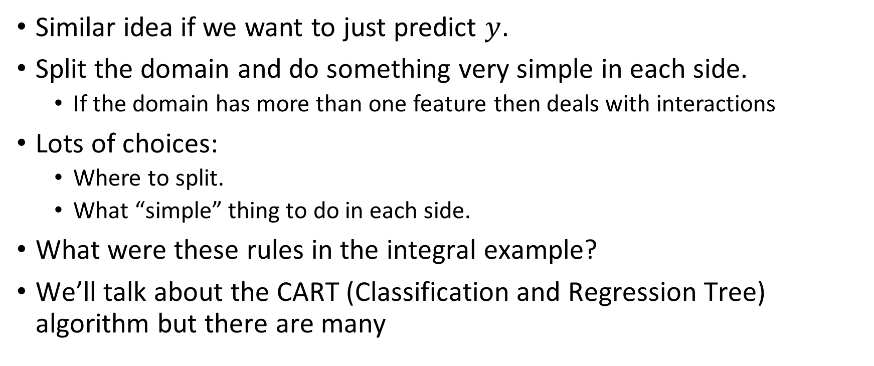
Regression trees
Similar idea if we want to just predict $y$.
Split the domain and do something very simple in each side.
If the domain has more than one feature then deals with interactions
Lots of choices:
Where to split.
What “simple” thing to do in each side.
What were these rules in the integral example?
We’ll talk about the CART (Classification and Regression Tree) algorithm but there are many

Slide 23
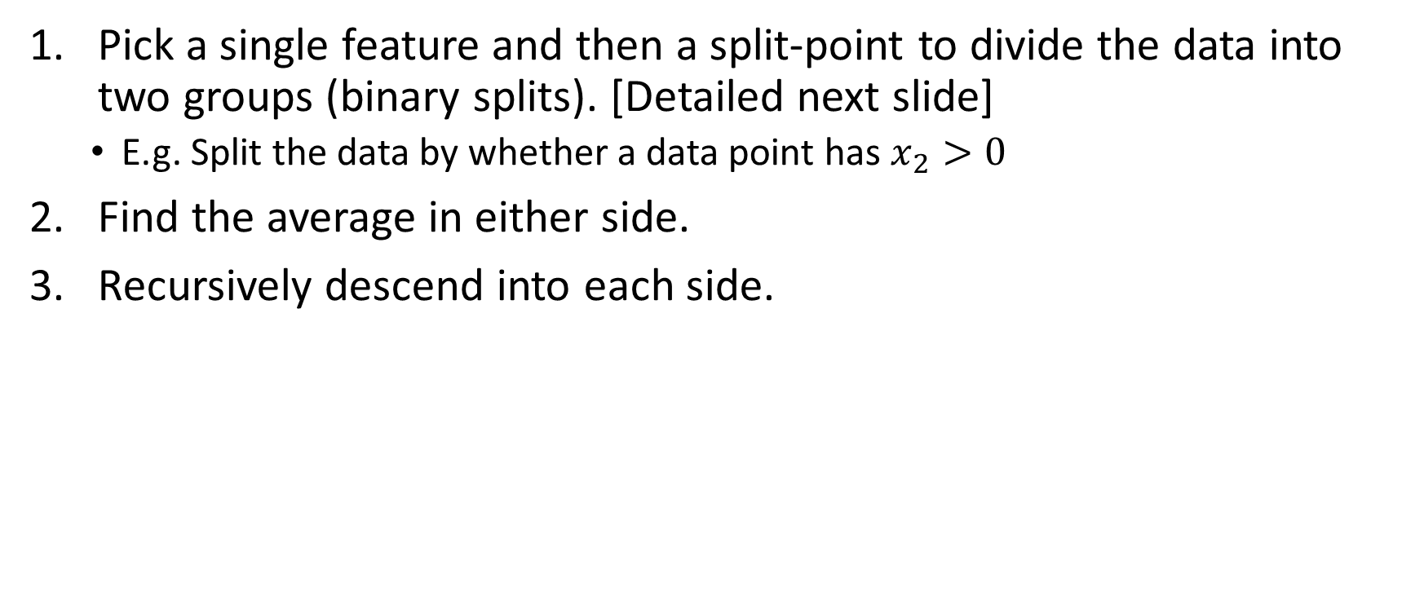
CART Steps
Pick a single feature and then a split-point to divide the data into two groups (binary splits). [Detailed next slide]
E.g. Split the data by whether a data point has $x_{2}>0$
Find the average in either side.
Recursively descend into each side.

Slide 24
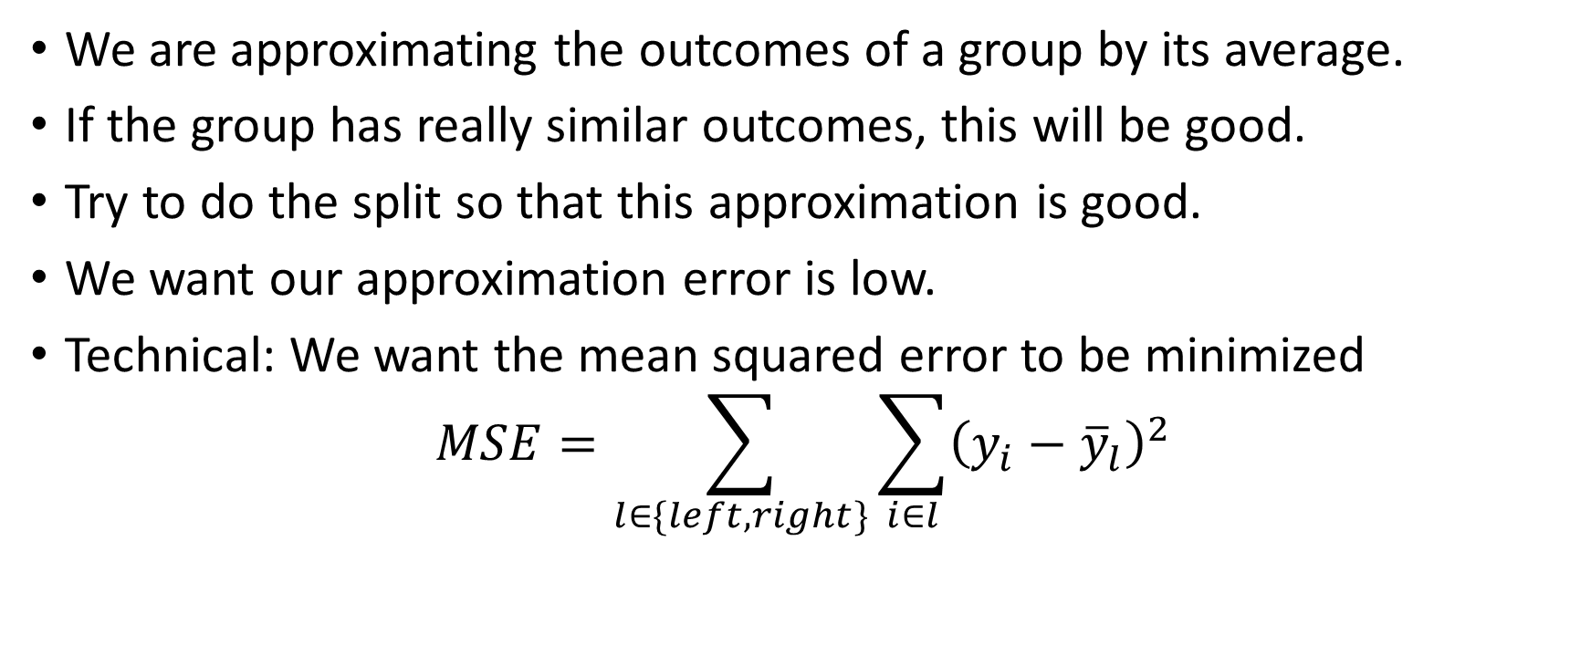
How to pick the split variable & split point?
We are approximating the outcomes of a group by its average.
If the group has really similar outcomes, this will be good.
Try to do the split so that this approximation is good.
We want our approximation error is low.
Technical: We want the mean squared error to be minimized
$$MSE=\sum_{l∈\{left,right\}}{\sum_{i∈l}{{\left(y_{i}−{\overline{y}}_{l}\right)}^{2}}}$$

Slide 25
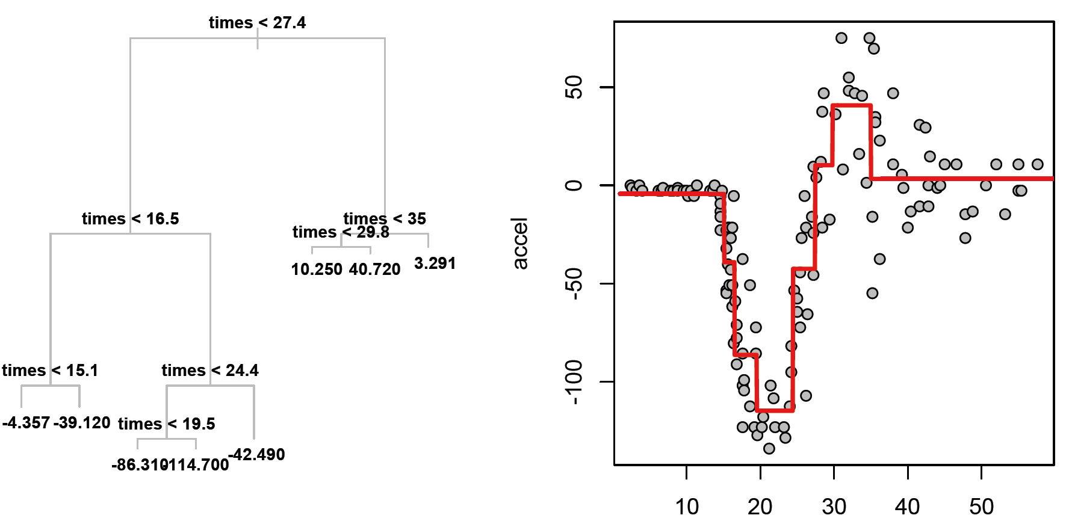

Tree Graphical Example
Motorcycle crash test data: $x$ it time from impact, $y$ is helmet acceleration
Credit: Matt Taddy

Slide 26

CART Example
Suppose we wanted to find how people’s height varied by their characteristics {gender, birth-month}.
We want to find $height=f(gender, birthmonth)$

Slide 27

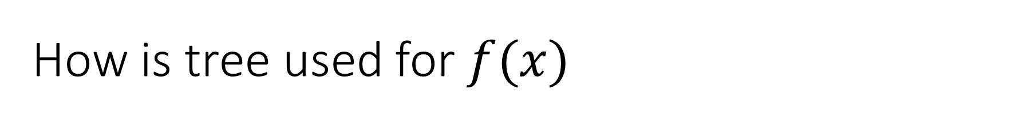
How is tree used for $f(x)$
How do we put new data $x′$ into tree to get prediction $f(x^{′})$?
Credit: Matt Taddy

Slide 28
When to stop?
Could keep splitting until you only end up with one node building a very deep/complex tree.
Is this good?
No, we would learn the noise of the data rather than the real relation.

Slide 29

CART stopping procedure
Optimal tree complexity is a (hyper-)parameter $α$.
Pick $α$ to minimize out-of-sample prediction error:
Split the data into train and test samples.
Build trees of varying complex on the train sample.
See which one does the best on the test sample.

Slide 30
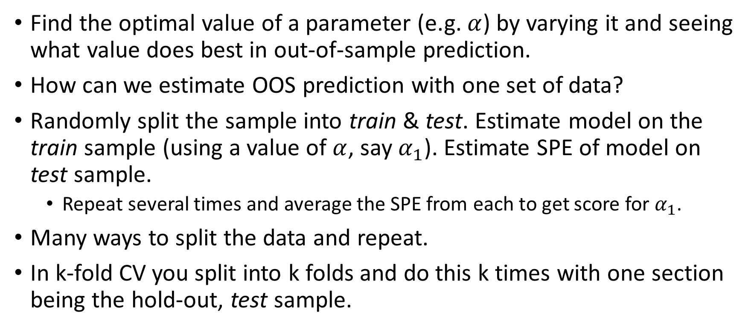
Cross-Validation?
Find the optimal value of a parameter (e.g. $α$) by varying it and seeing what value does best in out-of-sample prediction.
How can we estimate OOS prediction with one set of data?
Randomly split the sample into train & test. Estimate model on the train sample (using a value of $α$, say $α_{1}$). Estimate SPE of model on test sample.
Repeat several times and average the SPE from each to get score for $α_{1}$.
Many ways to split the data and repeat.
In k-fold CV you split into k folds and do this k times with one section being the hold-out, test sample.

Slide 31
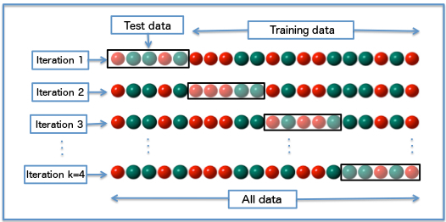
4-fold Cross-Validation Example

Slide 32
Forest
Average of a bunch of slightly different (deep) trees
How to get slightly different trees?
Jigger the rows: Randomly weight the observations
Jigger the columns: Randomly don’t allow some variables to be used for slitting
Forests usually better than tree but we don’t get the nice visual.

Slide 33
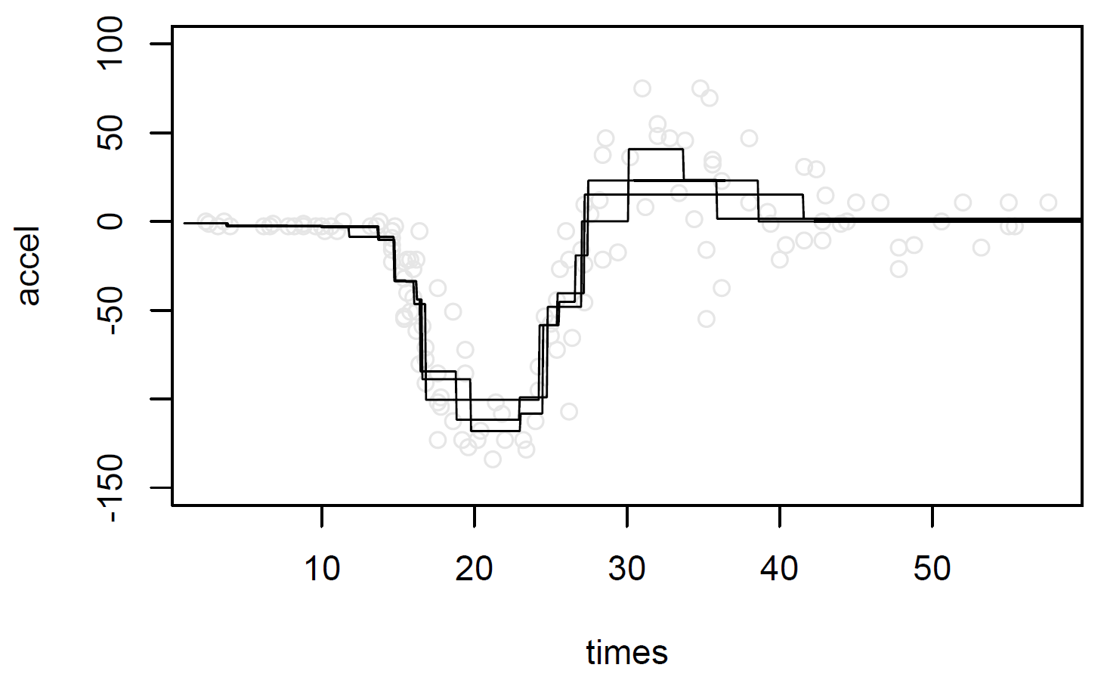
Forest Example: Composition
Make trees from bootstrap samples of the crash-test data
Credit: Matt Taddy

Slide 34
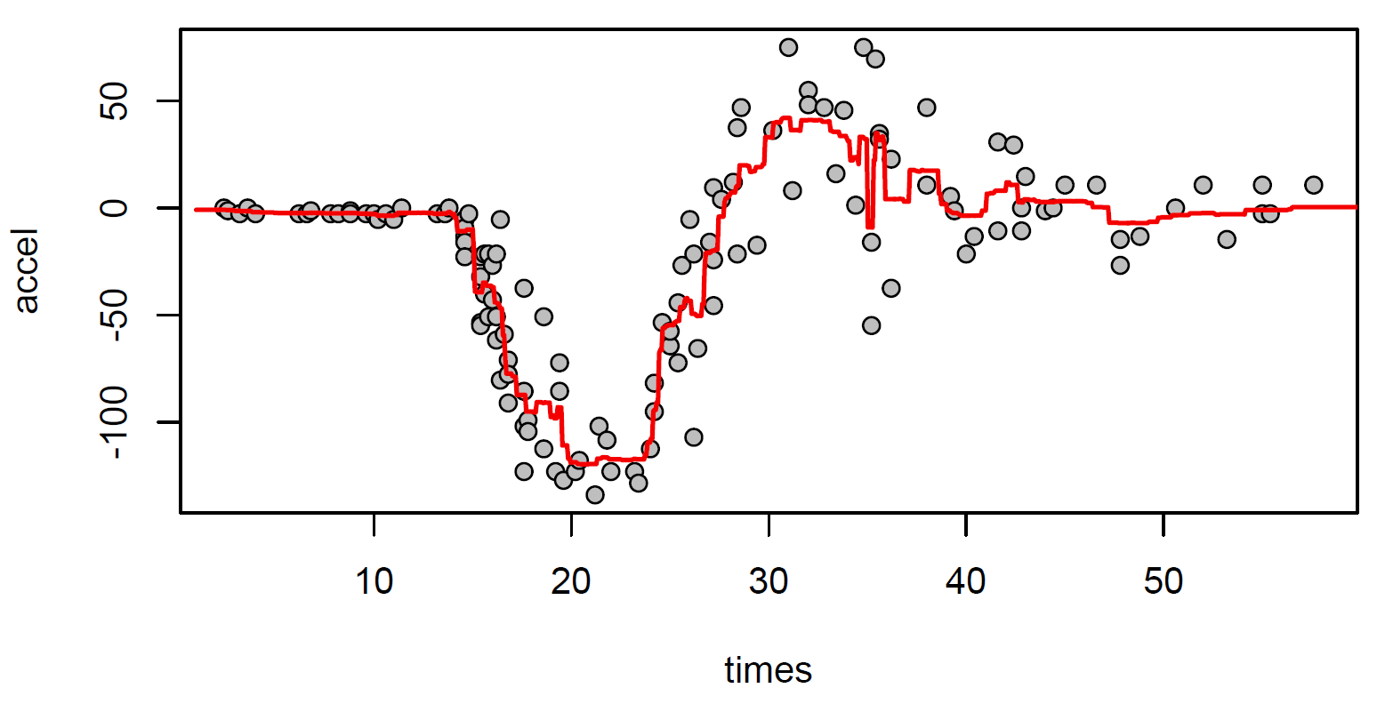
Forest Example: Average
Average the trees to get a forest. Better but not perfect.
Credit: Matt Taddy

